Slide 1
Boolean Algebra
SlideMake.com

Slide 2
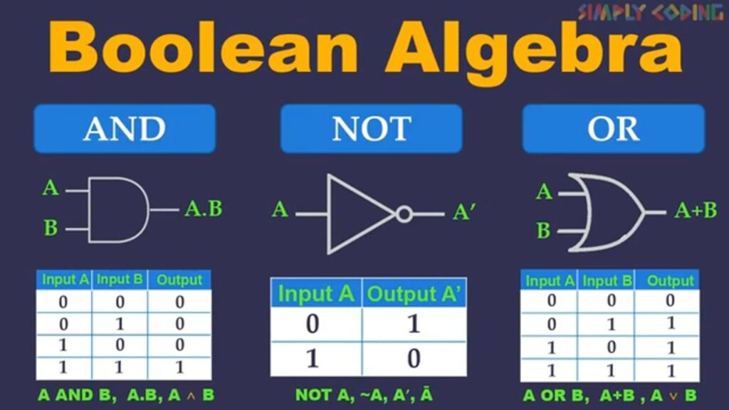
Introduction to Boolean Algebra
Boolean algebra is a branch of mathematics that deals with variables that have two distinct values: true and false.
It was developed by George Boole in the mid-19th century and laid the foundation for digital logic and computer science.
Boolean operations include AND, OR, and NOT, which can be used to create complex logical expressions.
Notes:
Image source: https://simplycoding.in

Slide 3

Basic Operations
The AND operation results in true only if both operands are true.
The OR operation yields true if at least one of the operands is true.
The NOT operation inverts the truth value of its operand, turning true into false and vice versa.
Notes:
Image source: https://www.slidemake.com

Slide 4
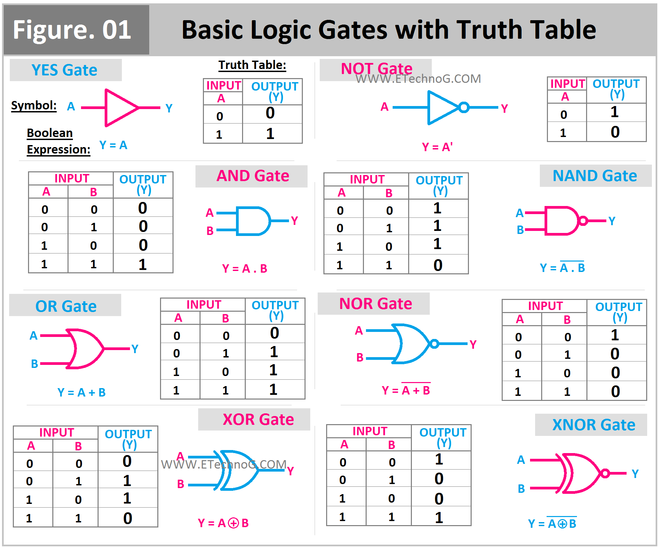
Truth Tables
Truth tables are a systematic way to represent the outputs of Boolean operations for all possible input combinations.
Each row of a truth table corresponds to a unique combination of input values and their resulting output.
Truth tables are essential for simplifying Boolean expressions and understanding logical relationships.
Notes:
Image source: https://i.pinimg.com

Slide 5
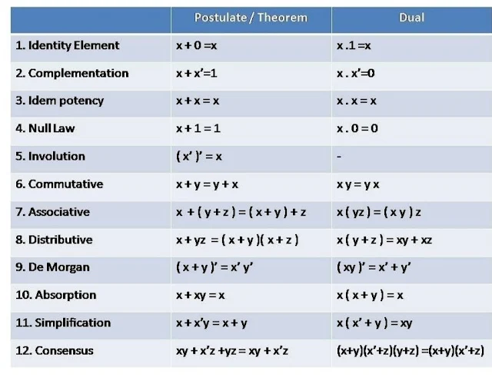
Laws of Boolean Algebra
Boolean algebra is governed by several fundamental laws, including the commutative, associative, and distributive laws.
The identity law states that any variable ANDed with true remains unchanged, while ORed with false also remains unchanged.
The complement law indicates that a variable ANDed with its complement equals zero, while ORed with its complement equals one.
Notes:
Image source: https://1.bp.blogspot.com

Slide 6
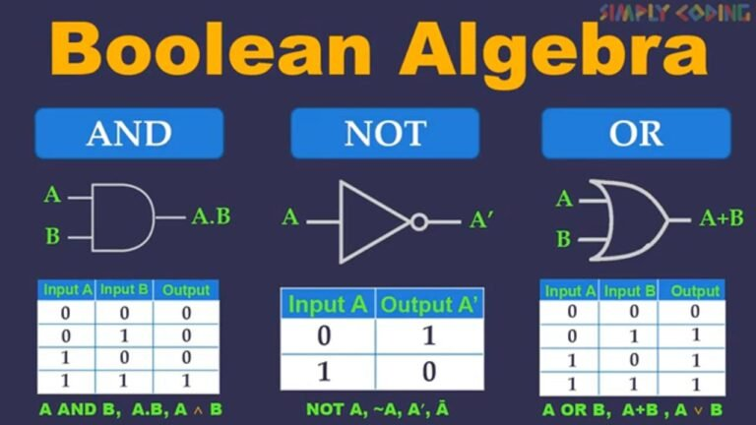
Applications of Boolean Algebra
Boolean algebra is widely used in computer science for designing digital circuits and algorithms.
It plays a crucial role in database searching, where Boolean operators help refine search queries for more accurate results.
Additionally, Boolean algebra is fundamental in programming, particularly in conditional statements and logical operations.
Notes:
Image source: https://simplycoding.in

